Slide 1
Can Money Buy Happiness?
A study of Country Happiness

Slide 2



What do you think?

Slide 3

World Happiness Report
The World Happiness Report is a landmark survey of the state of global happiness .
The reports review the state of happiness in the world today and show how the new science of happiness explains personal and national variations in happiness.
The happiness scores and rankings use data from the Gallup World Poll .

Slide 4

Gapminder
Gapminder is an independent educational non-proﬁt ﬁghting global misconceptions.
Gapminder aggregates various types of data such as Economy, Education, Health, Infrastructure, Population etc... For various countries around the world

Slide 5
Goal
We would like to identify what factors such impact the happiness of a country as measured by the world happiness report score and whether the historical trends of these factors can predict a country's happiness.
Understanding the factors that drive happiness at a country level can help us improve society and well being for humanity
Develop a model that can help us predict Happiness Scores for Countries.

Slide 6
What we found
Factors that were significant in the contribution to a Country’s Happiness were:
GDP Per capia
Social Support
Freedom to make life choices
Income per Capita
Income inequality in a country
The region in which a country belonged to

Slide 7
Predicting world happiness
We built a basic model to predict world happiness
Next step is to build a model only using Gapminder data which is collected for more countries than what is in the world happiness report.
With this data, we will be able to assign a happiness score for more countries
Afterwards we want to build a model using similar data at the individual level per country to see if we can predict individual happiness.

Slide 8
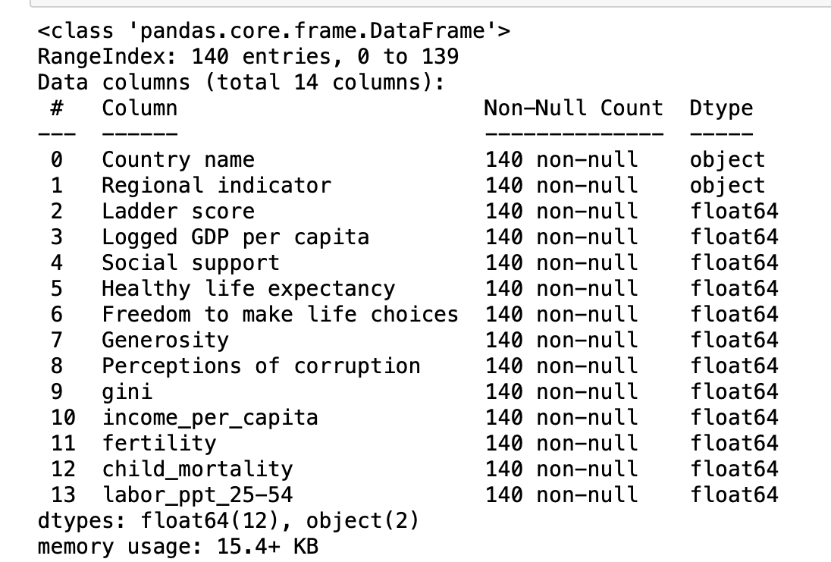
Appendix 1: Initial features

Slide 9
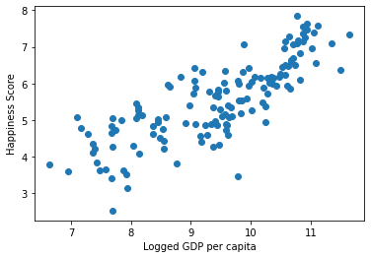
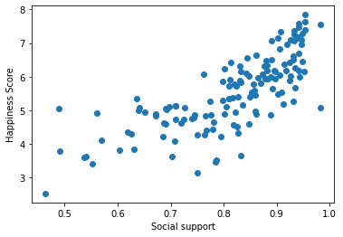
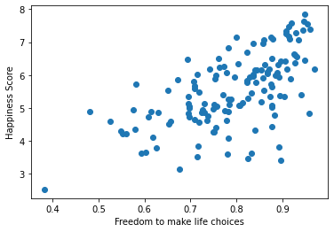
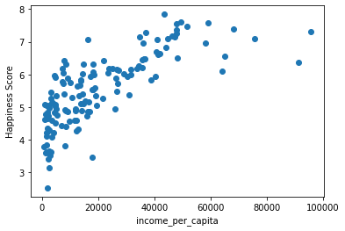
Appendix 2:

Slide 10
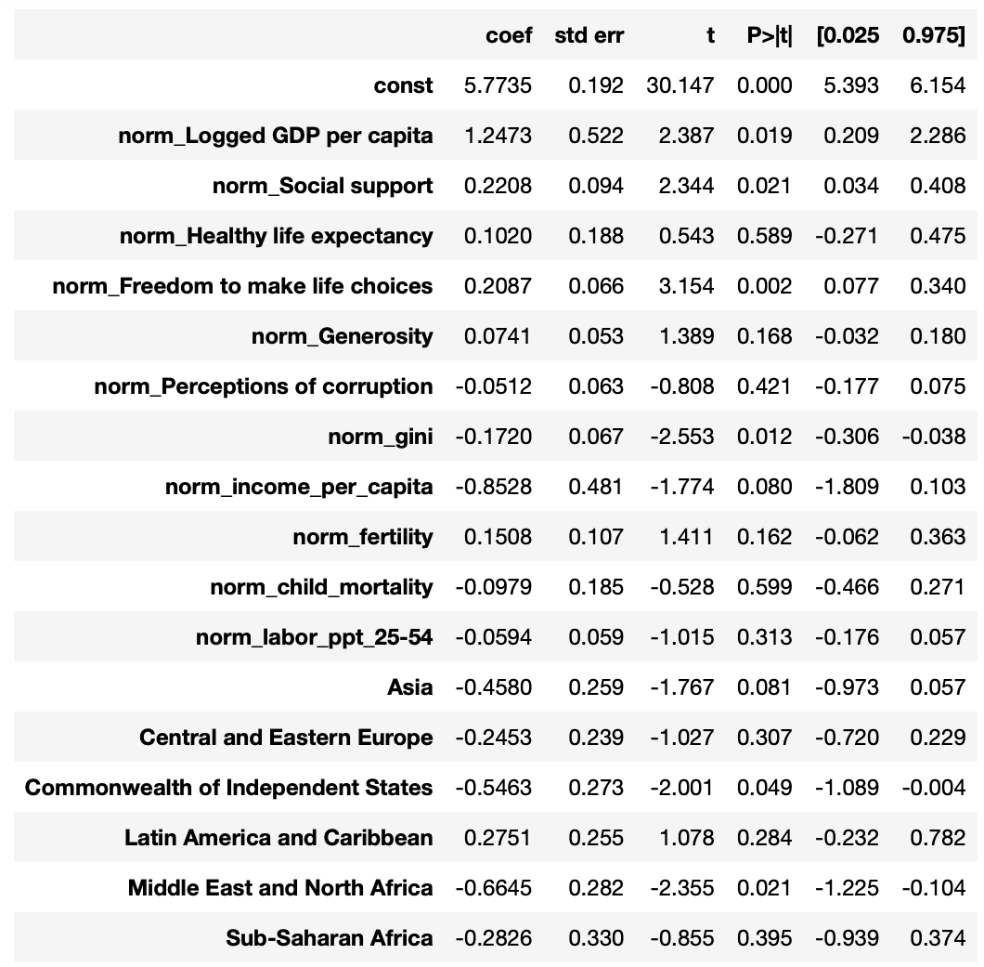
Appendix 3

Slide 11
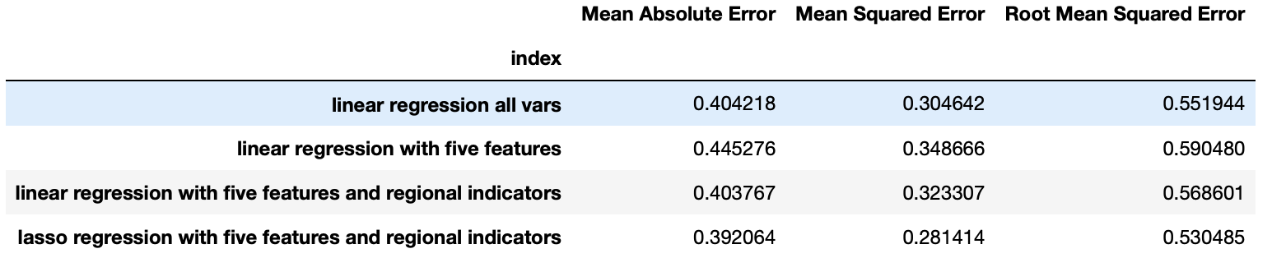
Appendix 4

